Slide 1
Build Your Chatbot with Dolly
Summary of the Databricks tutorial of building a chatbot using Dolly.

Slide 2
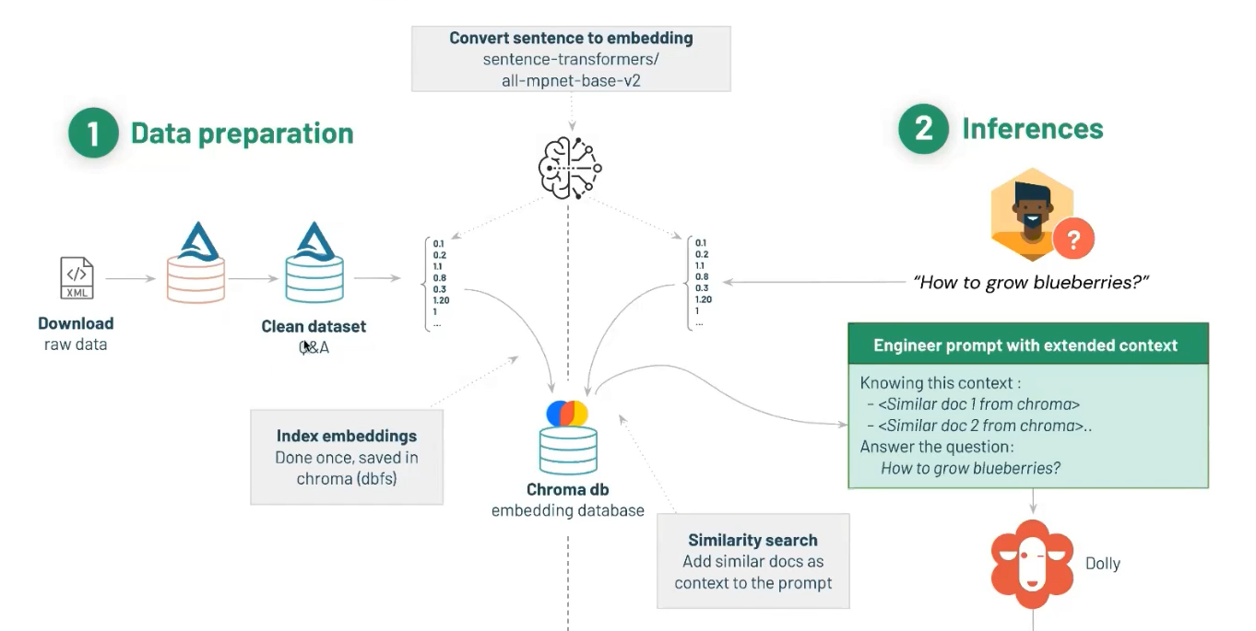
Overall Idea

Slide 3
Data Preparation
They extract and clean the data from some source and store it into a database in form of vectors i.e. all the data is converted into vectors of numbers and these vectors are stored in the database. These vectors will later be used as the source for performing similarity checks between the user input and the question that have been stored in the Database.
They are using BeautifulSoup to clean the data and Spark library to handle database.
They are using Chroma DB as the vector database.

Slide 4
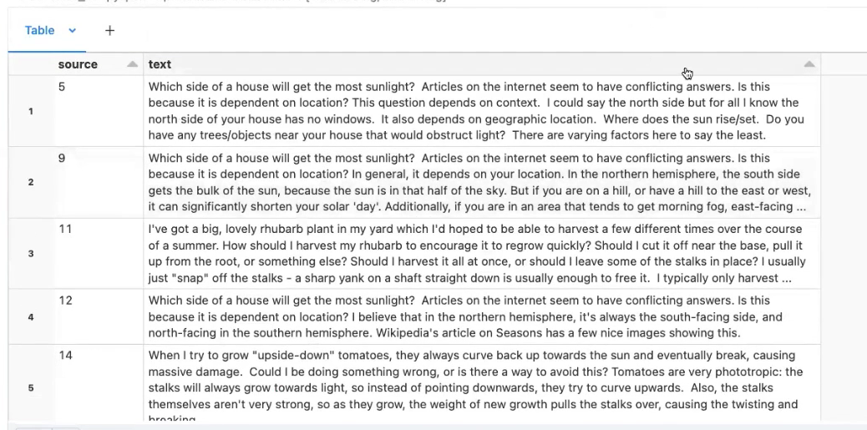
Format in Which they stored Data.

Slide 5
Similarity Testing and Prompt Generation
We first check the similarity of the user input with the database. Then, the answer corresponding to the question with most similarity is taken as the context for the question.
After we get the context for a given question a Prompt is created by feeding in context as well as user input to already designed prompt template. This prompt template is then feeded into the LLM and the LLM then generates the answer to the user input according to the given context and gives the output.
As we can choose what basic template of the prompt looks like so we can even make chat history a input for the prompt which can make the chatbot able to answer based on previous conversations.

Slide 6
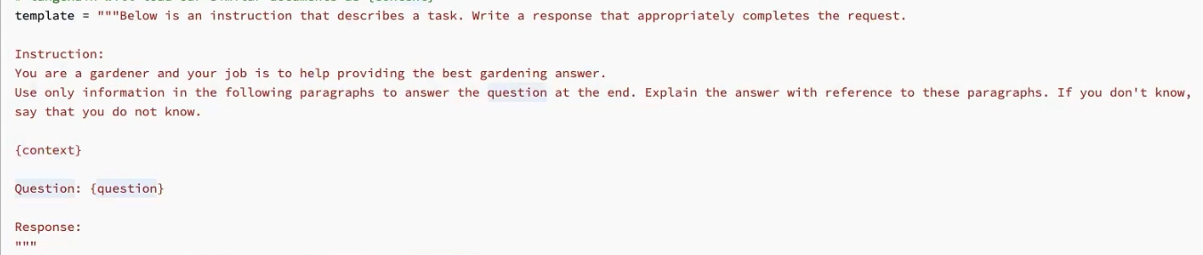
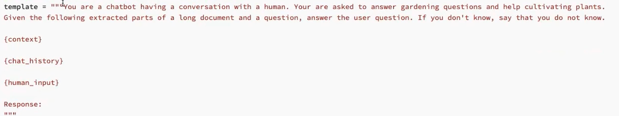
Example Prompts

Slide 7
Conclusion
That were the 3 main steps included in creating a chatbot using Dolly.
Data Preparation
Similarity checks
Prompt Engineering
The specific technologies used in intermediate steps are not mentioned as we can use many technology for it.

